Slide 1
Good morning!
7.04.2020
The 7th of April
Teacher᾿s name:Zhambolova Assem

Slide 2
Answers
A
D
A
A
D
Test
1.Which combination would have an attraction?
A) electrons and protons
B) none of the above
C) protons and neutrons
D) neutrons and electrons
2.Which is the value of the constant in Coulomb\'s equation?
A) k = 9 x 10^-9
B) k = 9.8
C) k = 6.67 x 10^-11
D) k = 9 x 10^9 ten the power of nine
3.Which scientist found the charge of an atom through his oil drop experiment?
A) Coulomb
B) Millikan
C) Newton
D) Franklin
4.Which factor is squared in Coulomb\'s law equation?
A) Distance
B) Charges
C) the constant
D) Force
5.What is the correct unit for charge?
A) Meters
B) Newtons
C) Kilograms
D) Coulombs

Slide 3
Cабақтың тақырыбы:
Электр тогы.
Электр тізбегі.
Theme of the lesson:
Electric current.
Electric circuit .

Slide 4
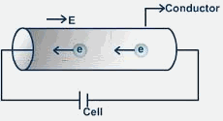
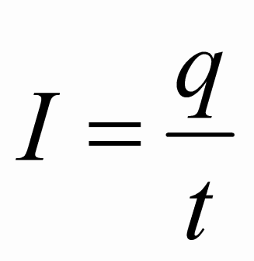
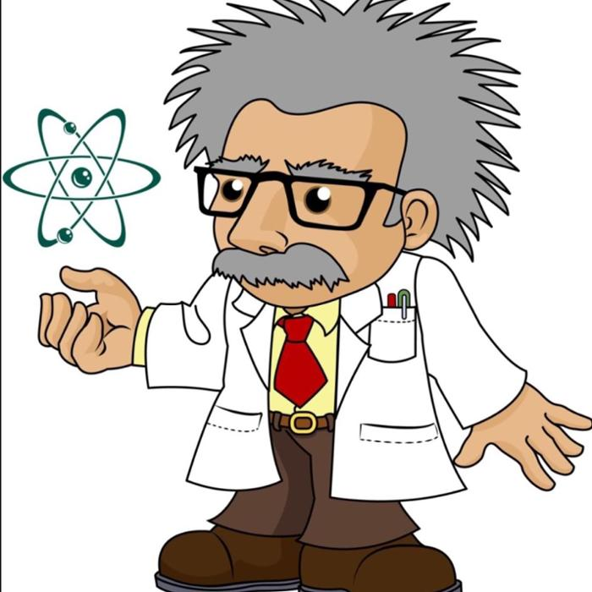
Current
Current is the amount of charge passing through a point in the circuit in one second.
I - Current (A)
q – Charge (C)
1t – time (s)
1A = 1Coulomb|1 second

Slide 5
Terminology

Slide 6
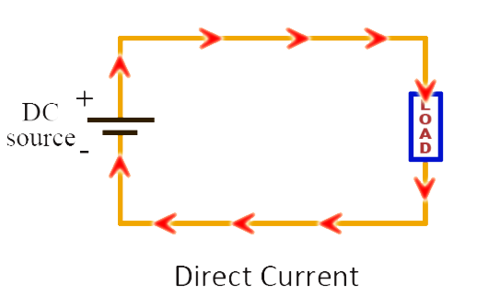

Slide 7
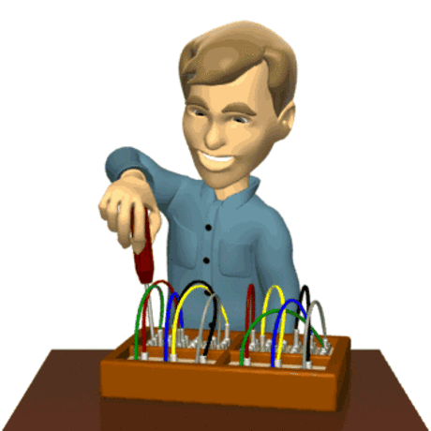
direct-current [dɪˈrekt-ˈkʌrənt]
electrical current that moves in one direction only

Slide 9
[ɪˈlektrɪk ˈkʌrənt]

Slide 11
Charge [ʧɑːʤ]
Charge [ʧɑːʤ]
to put electricity into an electrical device such as a battery:

Slide 13
Time [taɪm]
the part of existence that is measured in minutes, days, years, etc., or this process considered as a whole:

Slide 15
Device [dɪˈvaɪs]

Slide 17
cell [sel]
a device for producing electrical energy from chemical energy
battery [ˈbætərɪ]
a device that produces electricity toprovide power for radios, cars, etc.:

Slide 18
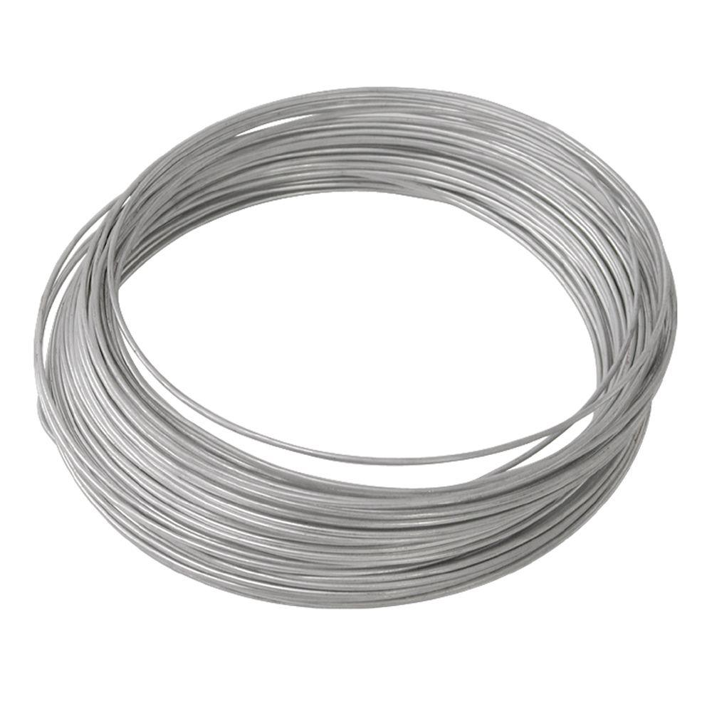
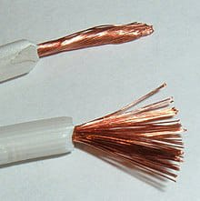

Slide 19
wire [ˈwaɪə]
a piece of thin metal thread that can be bent, used forfastening things and for making particular types of objects that arestrong but can bend:

Slide 21
conductivity [kɔndʌkˈtɪvɪtɪ]
the property of allowing heat or electricity to go through something, or the degree to which a substance allows this this:

Slide 22
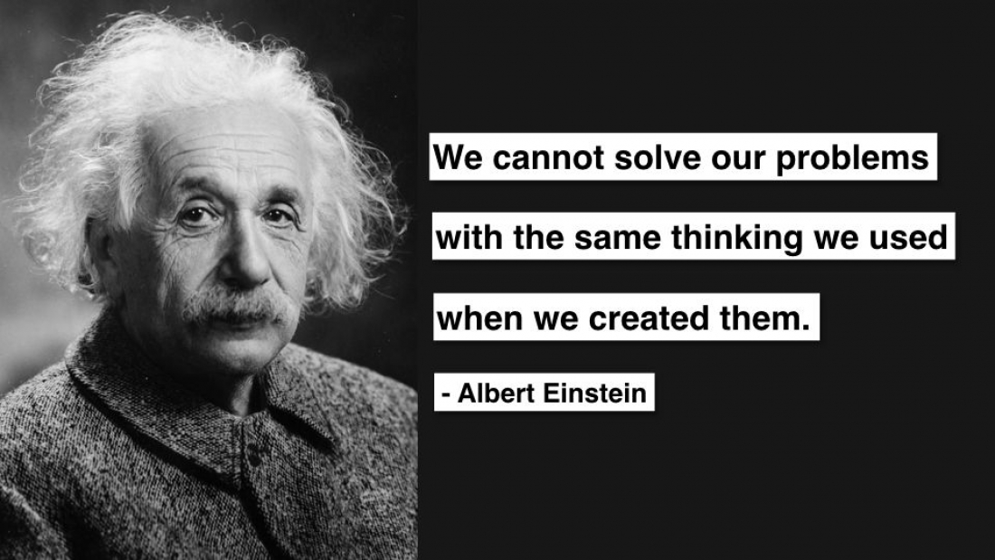

Slide 23
1) Find current in electric bulb, if electric charge of 300C travels through it during 10min.
2) What charge will travel during 3min through ammeter if current is 0.2A?
3) Current is 200A. What is the time the charge of 60000C travels through it?

